Slide 1
Introduction to AJAX

Slide 2
Introduction to AJAX
The request and response model for HTTP that we have used so far building PHP web applications is fairly primitive.
Each time a UI component is changed (e.g. typing a value into a textbox) the user has to submit the page or form back to the server for processing and wait for the whole page to be rendered back to their client machine.
In most cases this requires unnecessary data and processing e.g. the header and menu structure is requested and rendered but probably hasn’t changed since the last page request so this is wasteful.
The diagram on the next slide demonstrates the life cycle of subsequent page requests in a simple design showing that full page contents are refreshed for each request.

Slide 3
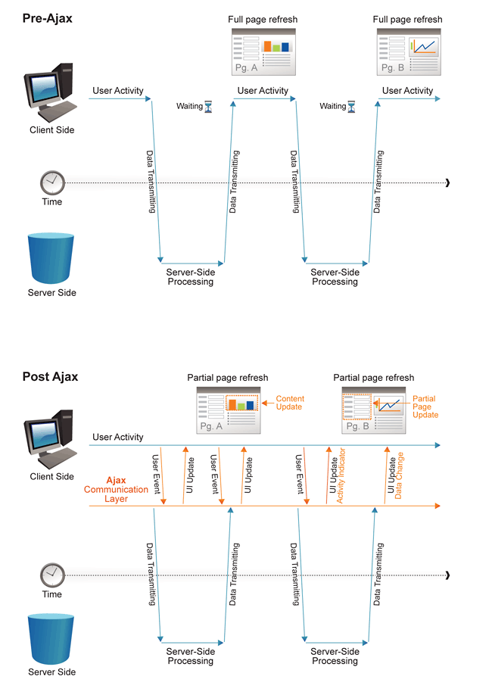
Full page refresh method
http://www.websiteoptimization.com/secrets/ajax/8-1-ajax-pattern.png

Slide 4
AJAX method
AJAX stands for Asynchronous JavaScript and XML and is the general idea that data is delivered to a web page when it is requested by an event in that page (UI event, timer event etc.) without disrupting the user experience with whole page refreshes.
The specific technologies involved in implementing an AJAX approach differ and in fact have changed over the years. For example the X meaning XML data format has been replaced by other ways of representing data e.g. JSON (we’ll come to that later). Technologies used include:
  HTML and CSS for presentation
  The Document Object Model (DOM) for dynamic display & interaction with data
  JSON or XML for the interchange of data from server to client
  The XMLHttpRequest object for asynchronous communication
  JavaScript to bring these technologies together
The diagram on the next slide demonstrates the life cycle of data requests in an AJAX style application design showing that only partial page contents are fetched or refreshed for each request event.
Introduction to AJAX

Slide 5
Async page refresh method
http://www.websiteoptimization.com/secrets/ajax/8-1-ajax-pattern.png

Slide 6
AJAX method
AJAX techniques are implemented in code on the client side primarily, and there are many libraries that offer simplified ways of doing this (e.g. jQuery)
In this part of the module though it is important to see how AJAX is implemented at the lowest level using raw JavaScript.
The basis of this process is the XMLHttpRequest object which was originally designed by Microsoft! around 1999 and later adopted by Mozilla, Apple, and Google. Since October 2014, it has been standardized (and will be superseded by fetch() in the future)
Despite its name, XMLHttpRequest can be used to retrieve any type of data, not just XML, and it supports protocols other than HTTP (including file and ftp).

Slide 7
XMLHttpRequest method
The XMLHttpRequest() method is the core of the process to establish a communication channel to a server application.
// This is the client-side script.
// Initialize the HTTP request.
var xhr = new XMLHttpRequest();
xhr.open('GET', 'send-ajax-data.php');
The object is created and the open() method is used to prepare a GET request (in this instance) to a PHP script. Once sent (see next slide), the PHP script will return some data which can then be processed by the client with more JavaScript.

Slide 8
XMLHttpRequest method
The XMLHttpRequest() method uses a send() method to initiate the request but needs to be told how to handle any data returned. Thus an event handler function needs to be added to the client script:
// Track the state changes of the request.
xhr.onreadystatechange = function () {
var DONE = 4; // readyState 4 means the request is done.
var OK = 200; // status 200 is a successful return.
if (xhr.readyState === DONE)
{
if (xhr.status === OK) {
console.log(xhr.responseText); // 'This is the output.'
}
else
{
console.log('Error: ' + xhr.status);
// An error occurred during the request.
}
}
};
// Send the request to send-ajax-data.php xhr.send(null);

Slide 9
PHP script to service the req
The send-ajax-data.php script sends data back from the server. This example just sends a string back.
<?php
// This is the server-side script.
// Set the content type.
header('Content-Type: text/plain');
// Send the data back.
echo "This is the output.";
?>
xhr.responseText in the JavaSctipt holds the returned server string value and this can be inserted into the DOM of the page.
The client UI via JavaScript can be made to trigger server calls like then when necessary to update part of the page without a complete page reload.

Slide 10
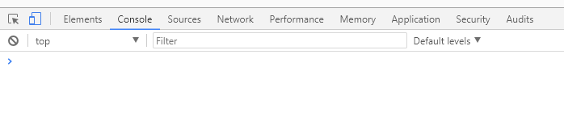
Workshop 15.1
Create an HTML page with the AJAX code on slides 186 and 187 in a <script> element and the PHP server code on slide 188 in a .php file in PHPStorm.
Load the page in Chrome and check the Console via the inspector to see that output string ”This is the output.” appears

Slide 11
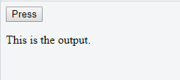
Workshop 15.2
The simple example in 15.1 executes the XMLHttpRequest when the page is loaded but it is more realistic to execute the call on a UI event such as a button press or text input action.
Add a text element (e.g. a <p>) and button to your webpage and modify the JavaScript code to wrap the xhr.send(null); call in a function that is called when the button is pressed – look back at your JavaScript workshops at event listeners. You can keep the xhr constructor and .Onreadystatechange code in a <script> element loaded when the page loads.

Slide 12
Workshop 15.3 – fetch()
fetch() method : fetch is a new native JavaScript API. Although not yet supported by all browsers, it is gaining momentum as a more popular way to execute Ajax. According to Google documentation, "Fetch makes it easier to make web requests and handle responses than with the older XMLHttpRequest.“
fetch('send-ajax-data.php').then(function(response)
{
return response.text();
}).then(function(data)
{
console.log(data);
}).catch(function(error)
{ console.log('Error: ‘ + error); });

Slide 13
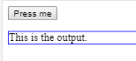
Workshop 15.4 – fetch() : 2
fetch() but working with the DOM:
<script>
function onclickHandler(event) {
document.getElementById('output').innerText = 'fetching...';
fetch('send-ajax-data.php').then(function (response) {
return response.text(); }).then(function (data) {
document.getElementById('output').innerText = data;
}).catch(function (error) {
document.getElementById('output').innerText ='Error: ' + error;
});
}
</script>
<button id="goButton">Press me</button>
<p style="border : 1px solid blue; " id="output">Output</p>
<script>
document.getElementById('goButton').addEventListener('click', onclickHandler, false);
</script>

Slide 14
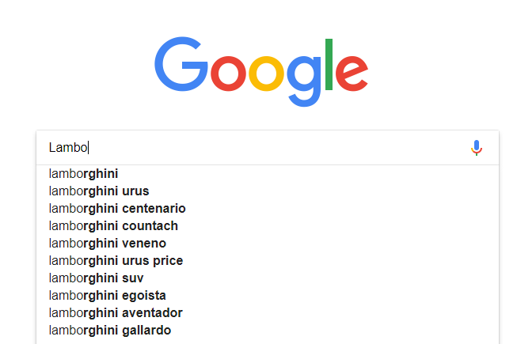
Workshop 15.5 – live search
Now we have seen the basics of loading data as required within a client web application we can put it to use. An example we have all seen below where Google’s search engine returns results suggestions as the user types

Slide 15
Workshop 15.5 – live search
The principle is straightforward:
  UI text control which triggers events when changed
  Event handler sends an AJAX type call to a server application with a text parameter in the query string
  Server application carries out a search and returns data
  Returned data is displayed in the UI without the need for a page refresh

Slide 16
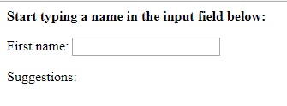
Workshop 15.5 – live search
UI controls part
<body>
<p>Start typing a name in the input field below:</p>
<form>
First name: <input type="text" onkeyup="showHint(this.value)">
</form>
<p>Suggestions: <span id="txtHint"></span></p>
</body>

Slide 17
Workshop 15.5 – live search
2) UI AJAX event handler part
<script>
function showHint(str) {
if (str.length == 0) {
document.getElementById("txtHint").innerHTML = "";
return;
} else {
var xmlhttp = new XMLHttpRequest();
xmlhttp.onreadystatechange = function() {
if (this.readyState == 4 && this.status == 200) {
var uic = document.getElementById("txtHint")
uic.innerHTML = this.responseText;
}
};
xmlhttp.open("GET", "gethint.php?q=" + str, true);
xmlhttp.send();
}
}
</script>

Slide 18
Workshop 15.5 – live search
Server script to carry out the search and return results
<?php
// Array with names
$a[] = "Anna";
$a[] = "Brittany";
$a[] = "Cinderella";
$a[] = "Diana";
$a[] = "Eva";
$a[] = "Fiona";
$a[] = "Gunda";
$a[] = "Hege";
$a[] = "Inga";
$a[] = "Johanna";
$a[] = "Kitty";
$a[] = "Linda";
$a[] = "Nina";
$a[] = "Ophelia";
$a[] = "Petunia";
$a[] = "Amanda";
$a[] = "Raquel";
$a[] = "Cindy";
$a[] = "Doris";
$a[] = "Eve";
$a[] = "Evita";
$a[] = "Sunniva";
$a[] = "Tove";
$a[] = "Unni";
$a[] = "Violet";
$a[] = "Liza";
$a[] = "Elizabeth";
$a[] = "Ellen";
$a[] = "Wenche";
$a[] = "Vicky“
. . .;

Slide 19
Workshop 15.5 – live search
4) Server script to carry out the search and return results
// get the q parameter, the text typed in, from URL
$q = $_REQUEST["q"];
$hint = "";
// lookup all hints from array if $q is different from ""
if ($q !== "") {
$q = strtolower($q);
$len=strlen($q);
foreach($a as $name) {
if (stristr($q, substr($name, 0, $len))) {
if ($hint === "") {
$hint = $name;
} else {
$hint .= ", $name";
}
}
}
}
// Output "no suggestion" if no hint was found or output results
echo $hint === "" ? "no suggestion" : $hint;

Slide 20
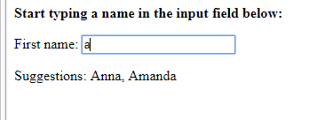
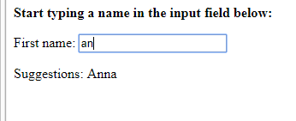
Workshop 15.5 – live search
User starts typing, server application is called and returns data.
As user types more characters the results return a more accurate match
Create this test application from the previous slides

Slide 21
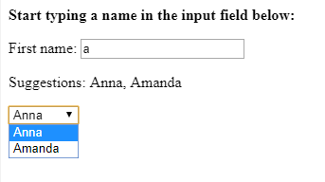
Workshop 15.6 – live search better UI component
It is useful if the returned values are displayed in an HTML form control such as a list box (<select>) so that the user can select one of them to move to the next part of the page feature
<select id="resultsSelectionBox">
</select>
uic = document.getElementById("resultsSelectionBox")
var names = this.responseText.split(',');
for (var i = 0; i<names.length; i++){
var opt = document.createElement('option');
opt.value = names[i];
opt.innerHTML = names[i];
uic.appendChild(opt);
}
Modify the JavaScript to split the csv list returned at the comma and create an <option> element per name returned in the <select> listbox.

Slide 22
Workshop 15.7 – live search with database
In example 15.5 a simple static array of values was used as the source of data which can be useful sometimes (e.g. looking up city names in a country where there is a finite list). When using this technique to search on larger datasets it would be better to connect to and search a database
Create an HTML page in the Student Data system built towards the end of the PHP workshops and create an AJAX function to call a PHP script which uses a function fetchStudents($searchText) based on the original function fetchAllStudents() StudentsDataSet class modified to take a text search parameter and return a set of comma separated values (as per 15.6)
Display the returned values in a UI component and make the returned values individually clickable.

